Slide 1
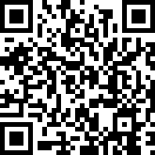
Please complete the ELEC5650 module evaluation
Access your module evaluations via:
Website: go to https://leeds.bluera.com/leeds/ to reach your personalized homepage.
When signing in:
Use your University of Leeds username (include @leeds.ac.uk at the end) and password.

Slide 2
ELEC5650
Medical Electronics and E-Health
(15 credits)
Dr Paolo Actis
p.actis@leeds.ac.uk

Slide 3
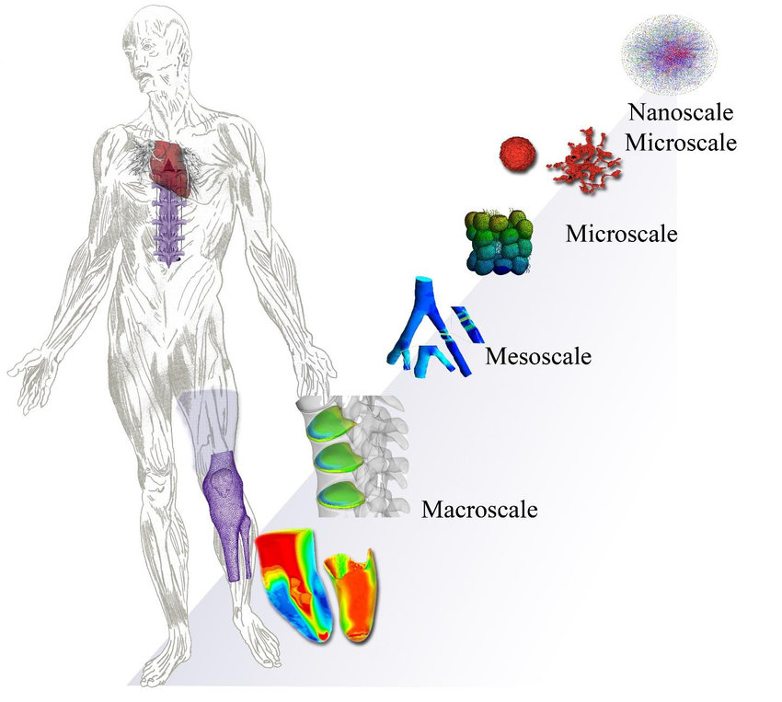
An electronics journey through the human body
Dernowsek et al, 2018, Biomechanics

Slide 4
Unit 1
DNA sequencing, protein biosensing, glucose sensing (including implantable sensors)
Unit 2
Excitable cells, wearable sensors, signal processing
Dernowsek et al, 2018, Biomechanics

Slide 5
Presentation
Date: 7th, 20th and 30th May (Prebooked only)

Slide 6
Presentation Tips
Familiarize with the marking rubric and make sure you address all parts in your presentation
Can be found under Assessment and Feedback and Module Information

Slide 7
Presentation Tips
Familiarize with the marking rubric and make sure you address all parts in your presentation
Make sure to address all questions that are part of the research challenge

Slide 8
Presentation Tips
Challenge 1: You are an engineering team at a wearable technology company. You have been asked by your Chief Technology Officer (CTO) to research the opportunities and challenges of the integration of wearable technology with glucose monitoring. The CTO has asked you to review the area broadly, but with the focus on the human/biosensor interface and the challenges associated with signal processing.

Slide 9
Presentation Tips
Make sure to address all questions that are part of the signal processing task

Slide 10
Presentation Tips
Task 1) Design a filter in Matlab/python to remove the high frequency noise
Task 2) Display the de-noised data and discuss the performance of the filter
Task 3) Develop/apply peak detection routines to automatically detect the high/low peaks in glucose
Task 4) Analyse what is the physiological relevance of these peaks and discuss what are the ethical implications of a breach of CGM data. For example, you can discuss what information about the lifestyle of the module leader you can (or can’t) extract from the data (i.e when does the module leader go to sleep, when does he eat breakfast, does he exercise regularly? ,..

Slide 11
Past Presentation Examples
Can be found under Assessment and Feedback

